Slide 1

smith to the rescue
Saied Seghatoleslami ad2cc
July 22, 2023

Slide 2
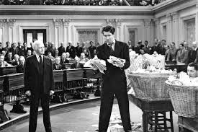
Not the one who went to Washington

Slide 3

…AND Not agent smith

Slide 4
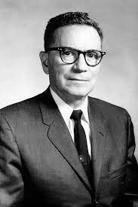
… Phillip smith
Born April 29, 1905 in Lexington, MA
Died August 29, 1987 in Berkley Heights, NJ
Graduated from Tufts Collage in 1928
Retired from Bell Telephone Laboratories 1970
Elected Fellow of IRE 1952
Book published in 1969 “Electronic Applications of the Smith Chart: In Waveguide, Circuit, and Component Analysis”
Smith explained, "From the time I could operate a slide rule, I've been interested in graphical representations of mathematical relationships."

Slide 5
Objectives
Understand why we care about Smith Charts
Look at some real-life antennas and see that they are not “just a resistor”
Stare at a Smith Chart (individual copies) and explore what is in there
Review some Smith Chart recipes
Solve a few problems using a Smith Chart
Look at one other use of a Smith Chart (RF Transistor data sheet)

Slide 6
So, What does it do?
Smith Chart Takes the Drudgery Out of Radio Frequency (RF) Circuit Calculations
For Different Kinds of Antennas, RF Circuits, Transmission Lines…

Slide 7
Why smith charts?
The alternatives are:
  Tedious and error prone (i.e., drudgery)
  Provide very little insights or help with intuition
What about computers?
  They take the tedium out
  But they give you even less insight
Smith Charts
  Simplify the task
  Give you insights and intuition about what is going on
  …and you can do Smith Charts with computers

Slide 8
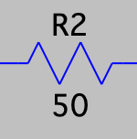
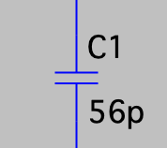
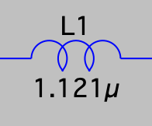
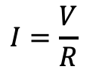
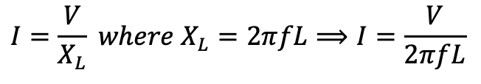
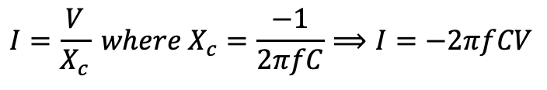
R, L, and C
R: resistance
X: reactance
Resistor – put a voltage across it, get a current through it
$$I=\frac{V}{R}$$
Capacitor, not so simple – put a voltage across it, you must ask what what is the frequency?
$$I=\frac{V}{X_{c}} where X_{c}=\frac{−1}{2πfC}⟹I=−2πfCV$$
Inductors are also complicated – put a voltage across it, you must ask what what is the frequency?
$$I=\frac{V}{X_{L}} where X_{L}=2πfL⟹I=\frac{V}{2πfL}$$
Capacitor: The higher the frequency and the higher the capacitance, the lower the reactance (which is like resistance)
Inductor: The higher the frequency and the higher the inductance, the higher the reactance

Slide 9
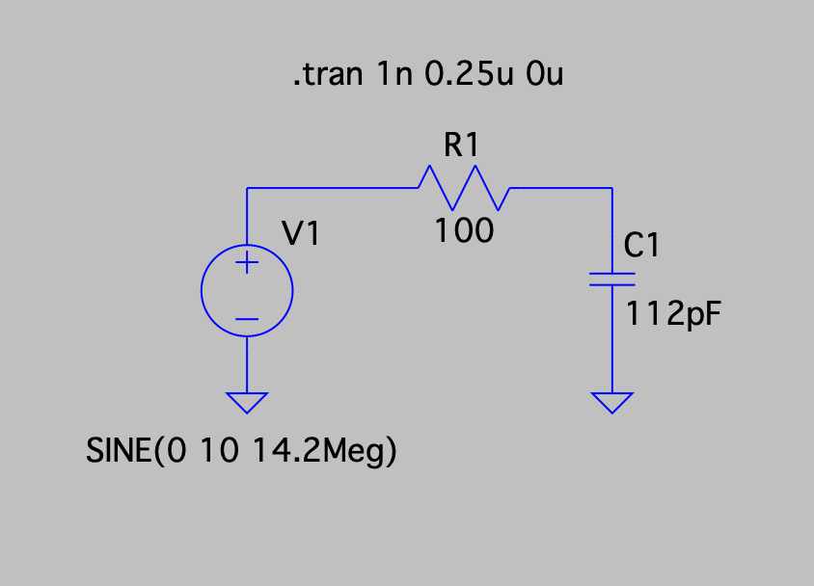
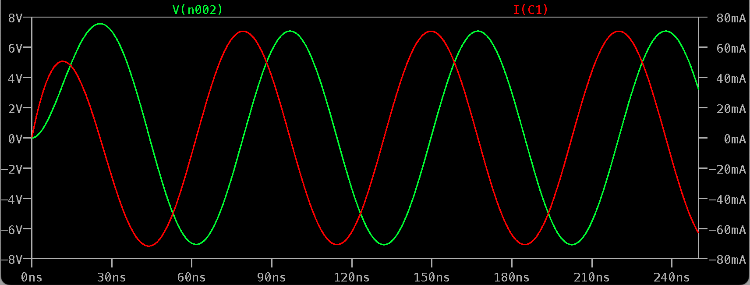
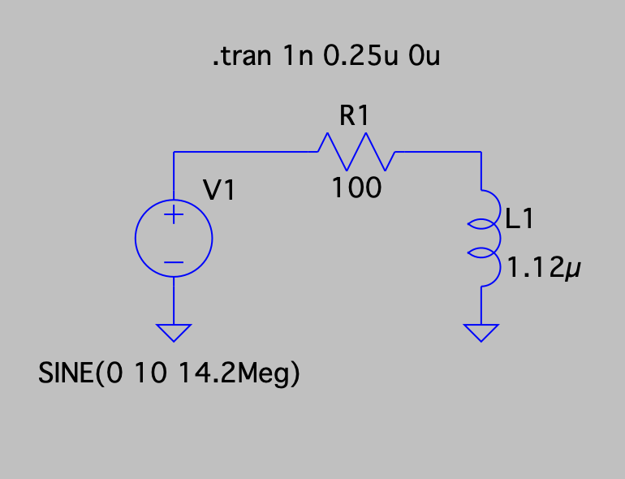
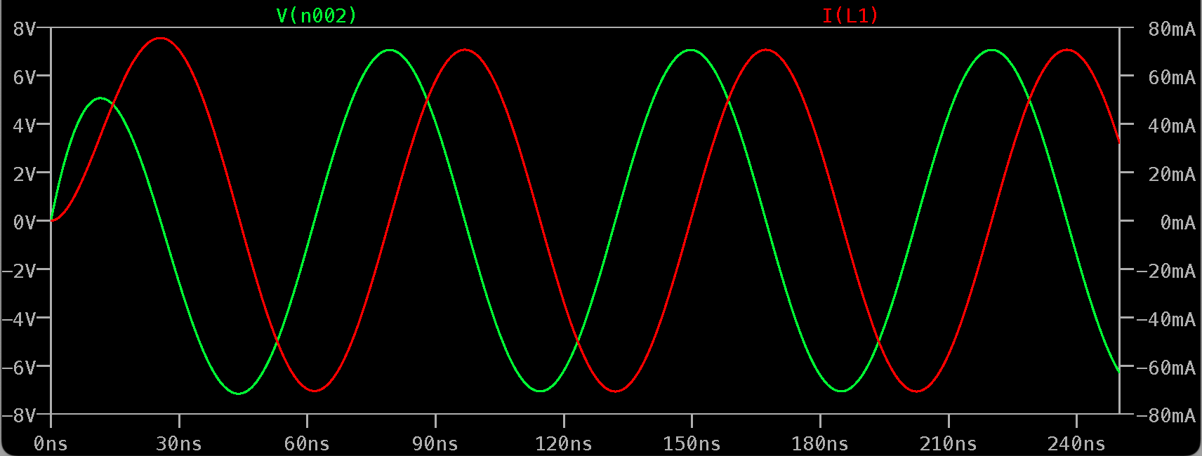
90º
360º

Slide 10
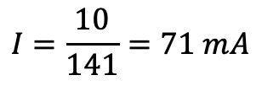

…reactance has “phase”
y
y
X Inductive
Z
Inductor current
R
Resistor current
x
x
Voltage
Capacitor current
X capacitive
$$Z=\sqrt{{100}^{2}+{100}^{2}}=141 Ohms$$
$$I=\frac{10}{141}=71 mA$$

Slide 11
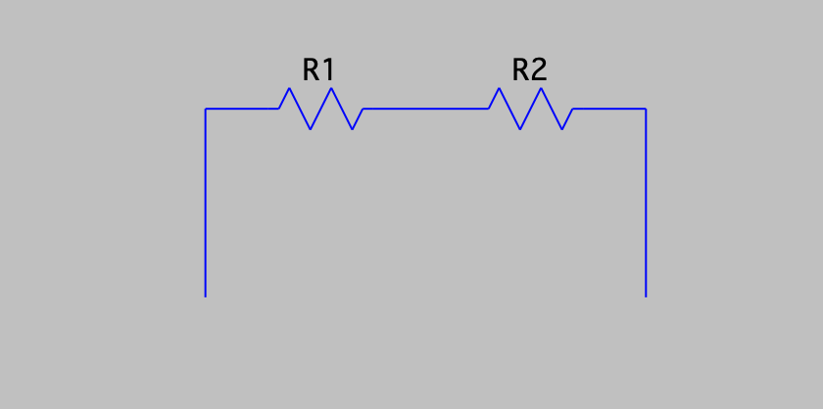
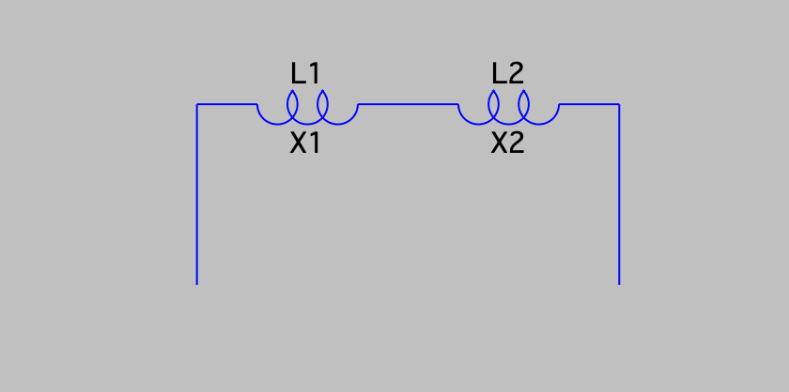
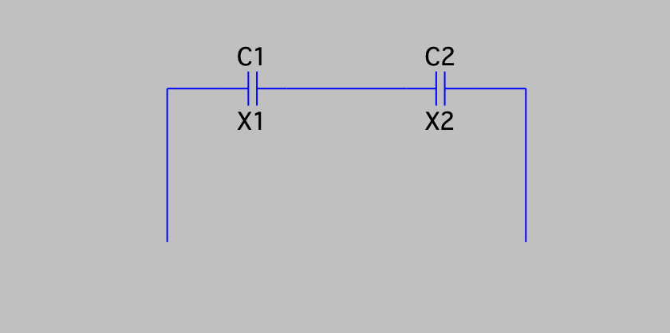



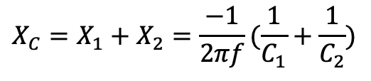


Series circuits
$$R$$
$$X_{L}$$
$$X_{C}$$
$$X_{C}=X_{1}+X_{2}=\frac{−1}{2πf}(\frac{1}{C_{1}}+\frac{1}{C_{2}})$$
$$R=R_{1}+R_{2}$$
$$X_{L}=X_{1}+X_{2}=2πf(L_{1}+L_{2})$$

Slide 12
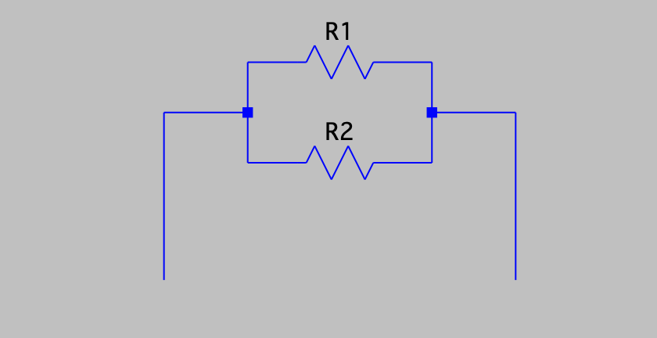
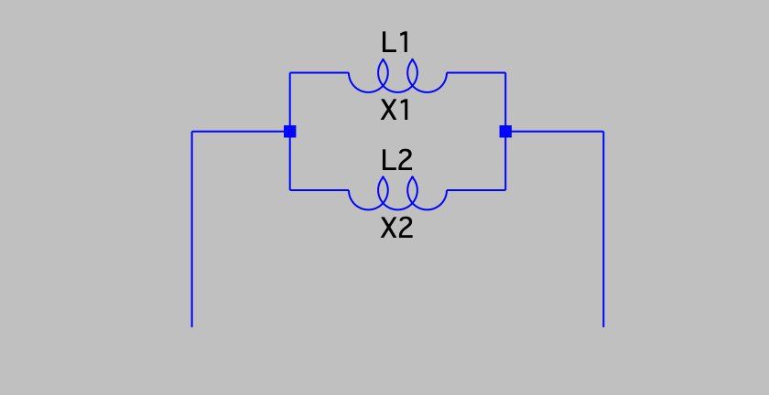
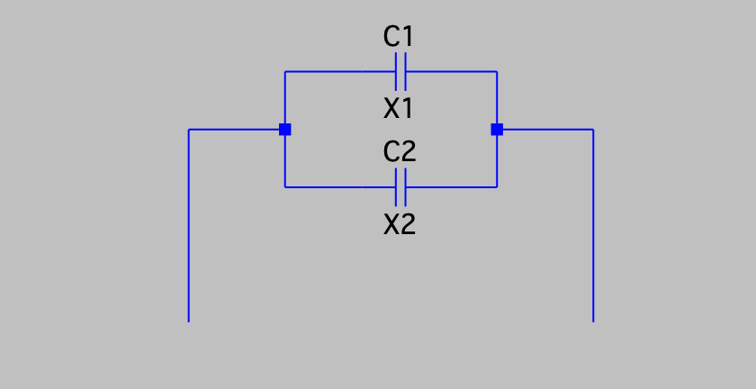
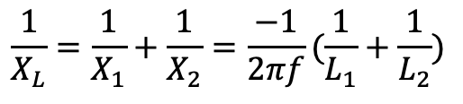


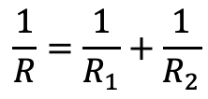
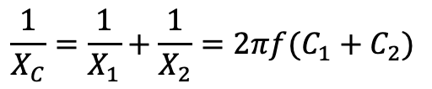

Parallel circuits
$$R$$
$$X_{L}$$
$$X_{C}$$
$$\frac{1}{R}=\frac{1}{R_{1}}+\frac{1}{R_{2}}$$
$$\frac{1}{X_{L}}=\frac{1}{X_{1}}+\frac{1}{X_{2}}=\frac{−1}{2πf}(\frac{1}{L_{1}}+\frac{1}{L_{2}})$$
$$\frac{1}{X_{C}}=\frac{1}{X_{1}}+\frac{1}{X_{2}}=2πf(C_{1}+C_{2})$$

Slide 13
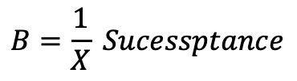

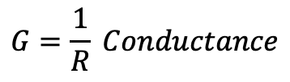
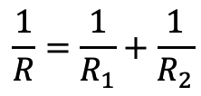


Parallel World
$$R$$
$$X_{L}$$
$$X_{C}$$
$$\frac{1}{R}=\frac{1}{R_{1}}+\frac{1}{R_{2}}$$
$$\frac{1}{X_{L}}=\frac{1}{X_{1}}+\frac{1}{X_{2}}=\frac{−1}{2πf}(\frac{1}{L_{1}}+\frac{1}{L_{2}})$$
$$\frac{1}{X_{C}}=\frac{1}{X_{1}}+\frac{1}{X_{2}}=2πf(C_{1}+C_{2})$$
$$G=\frac{1}{R} Conductance$$
$$B=\frac{1}{X} Sucessptance$$
$$G=G_{1}+G_{2}$$
$$B_{L}=B_{1}+B_{2}$$
$$B_{C}=B_{1}+B_{2}$$

Slide 14
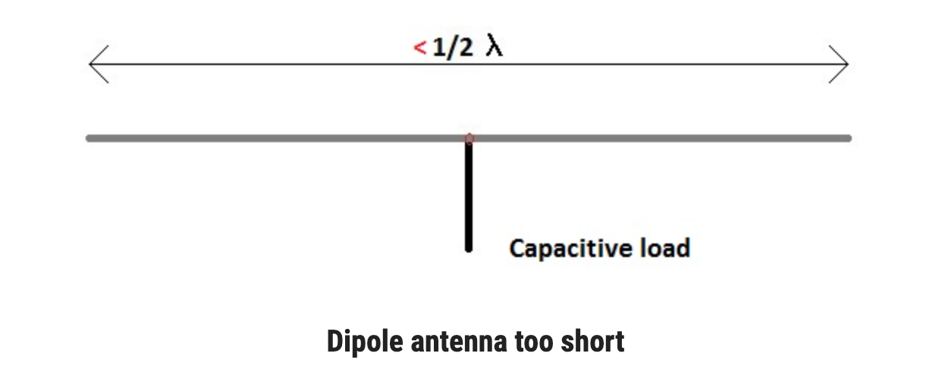
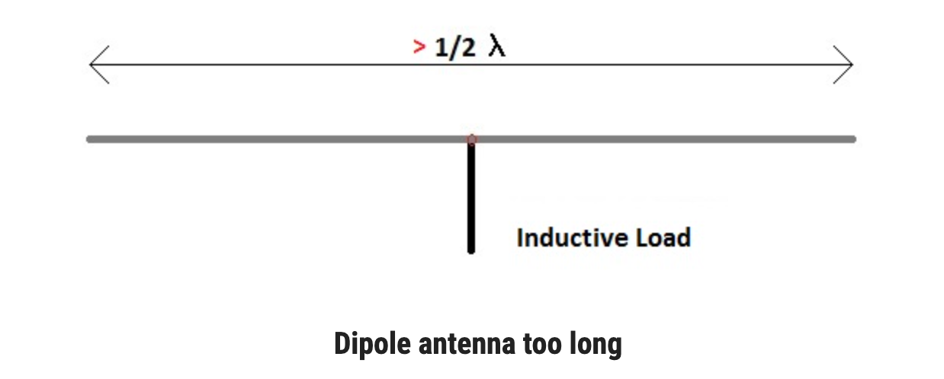
Real life antennas

Slide 15
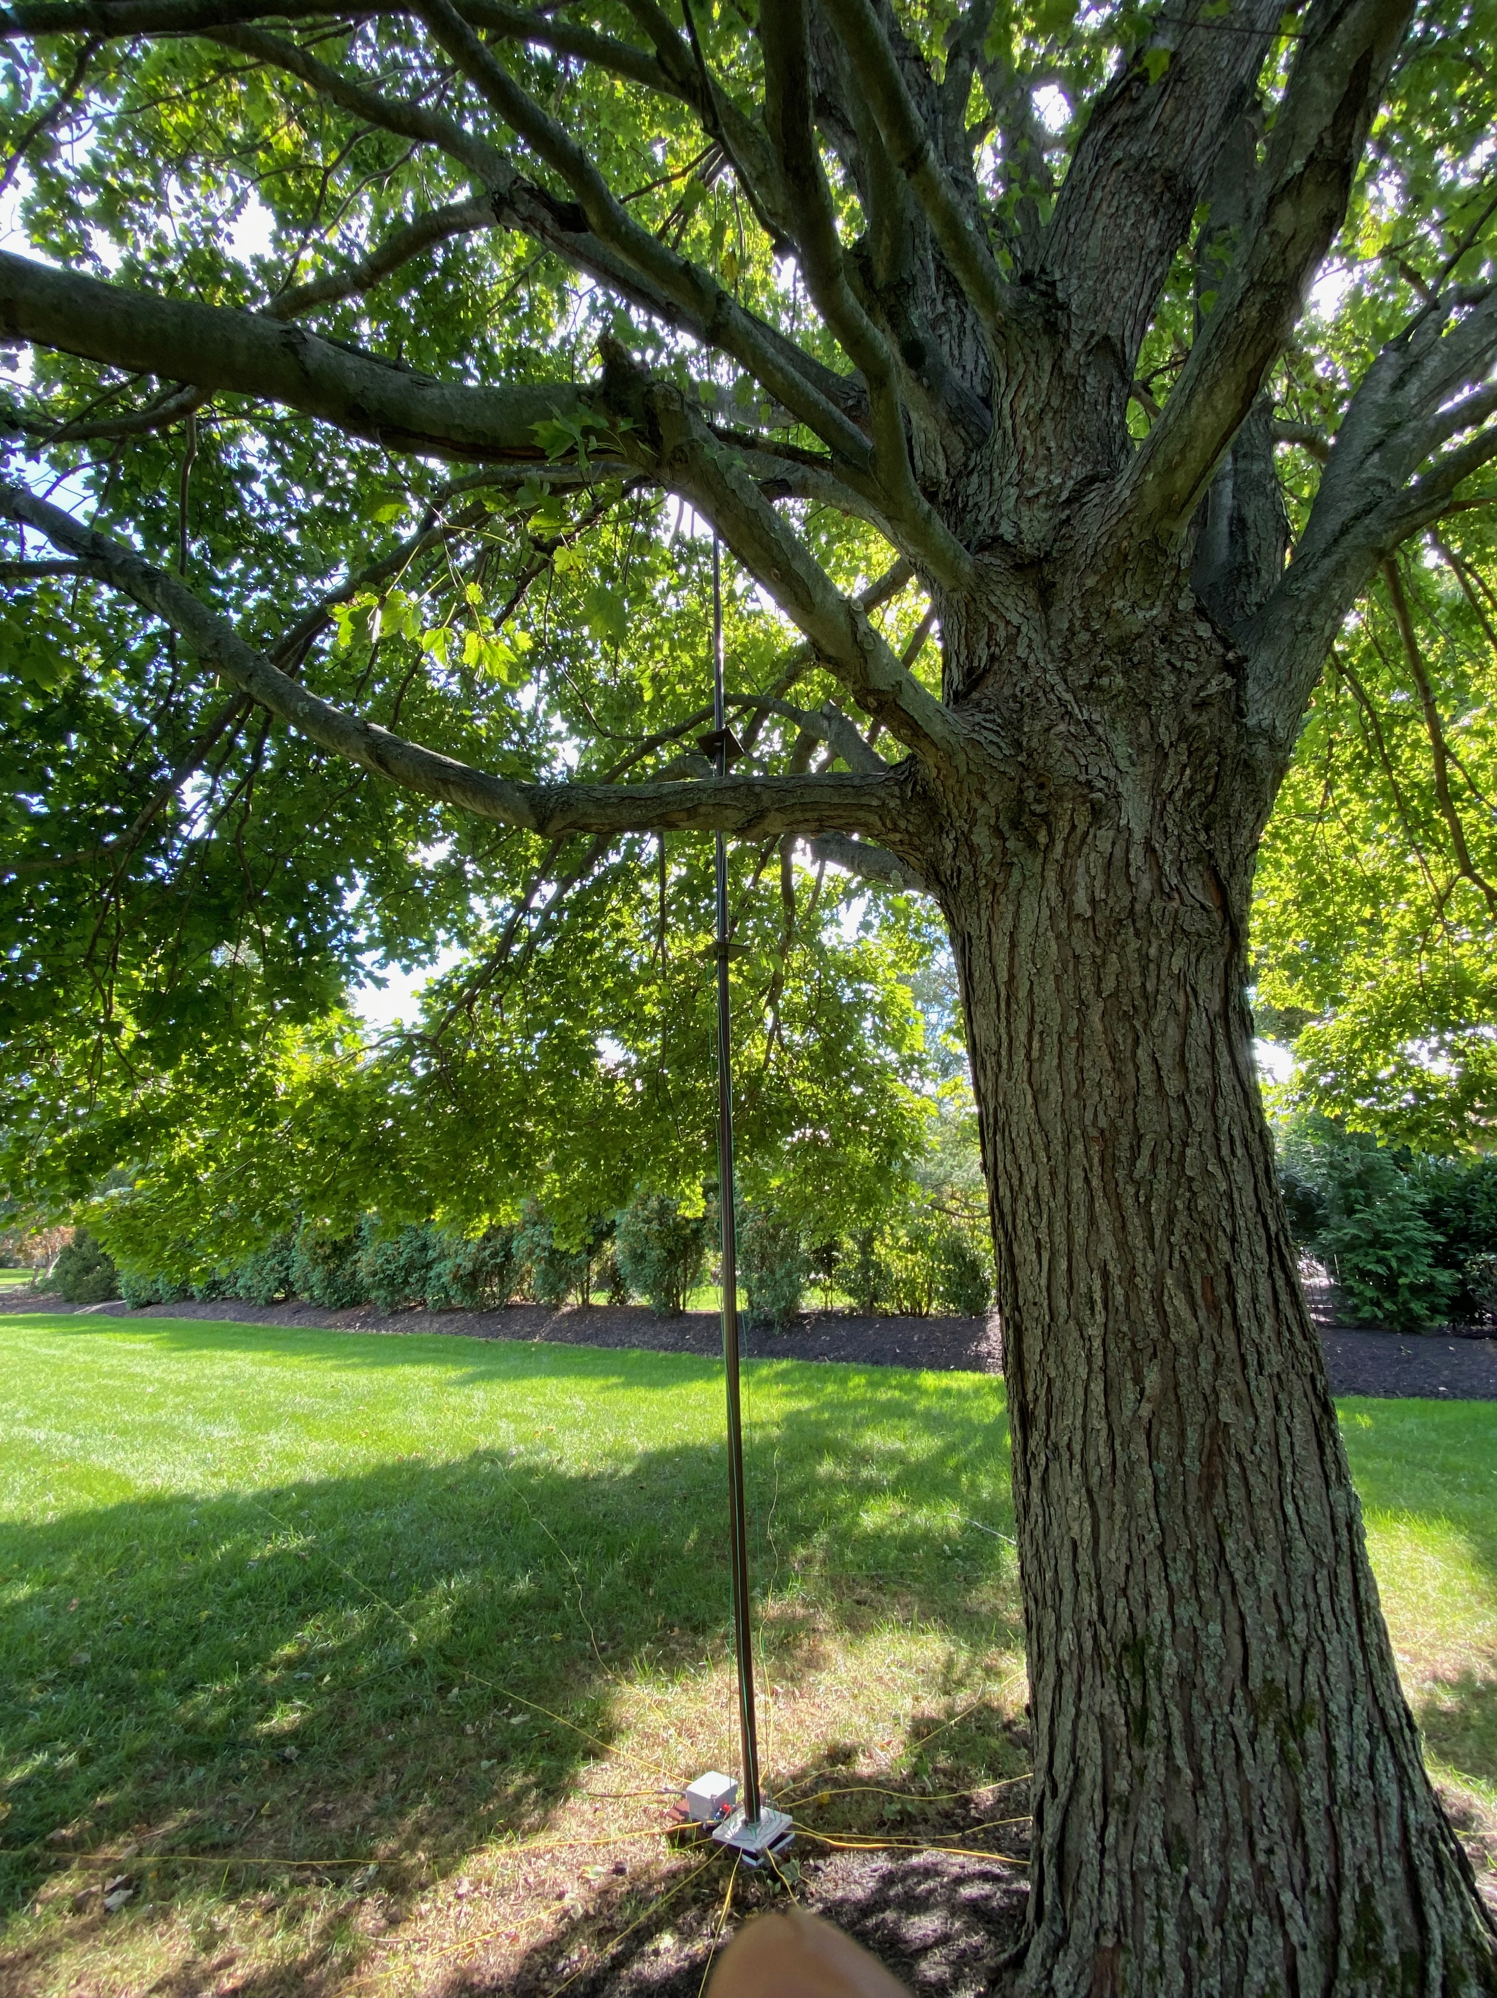

Slide 16
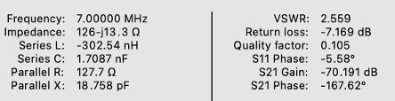
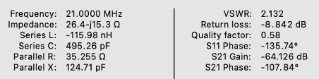
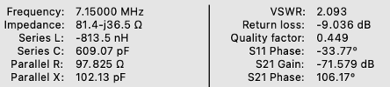
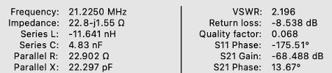
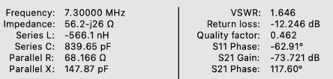
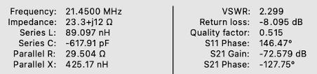
Two of my antennas
40 m
15 m

Slide 17
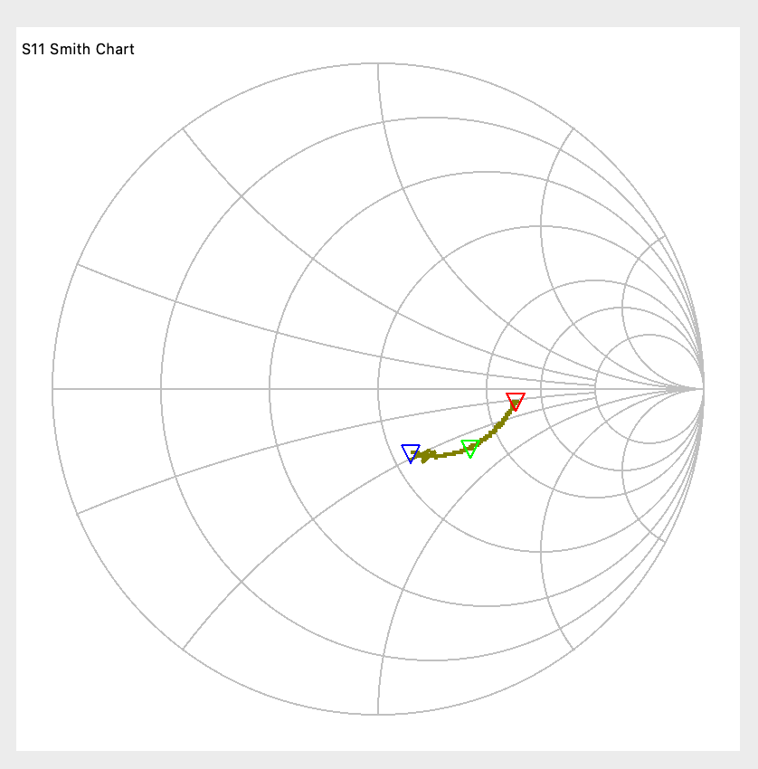
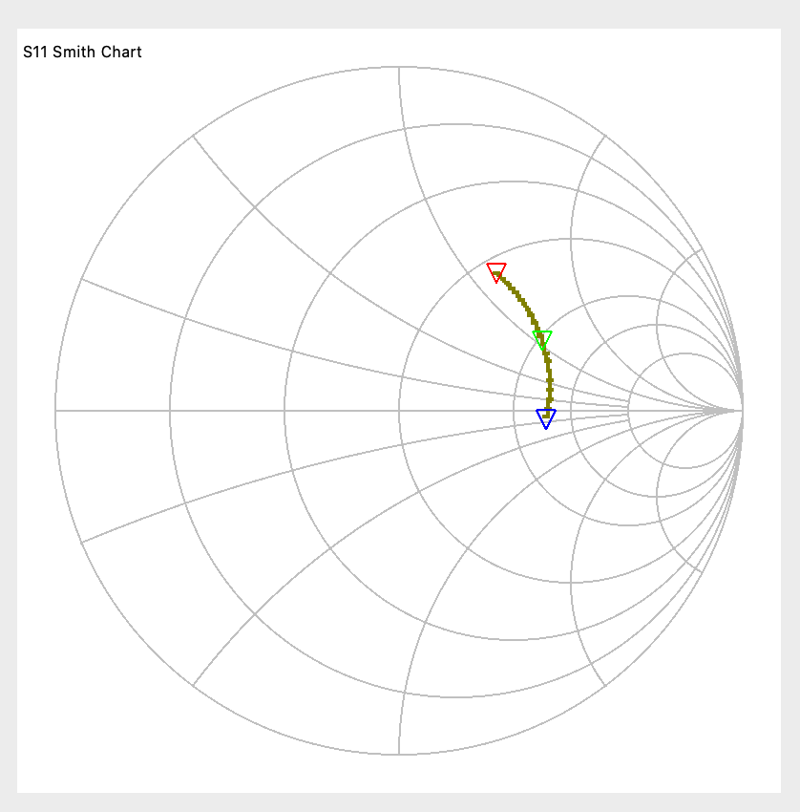
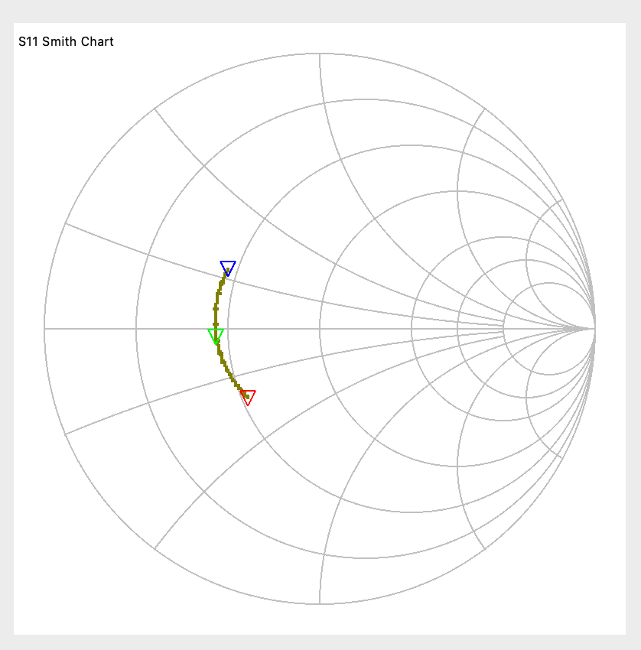
Some of My antennas
40 m
20 m
15 m

Slide 18
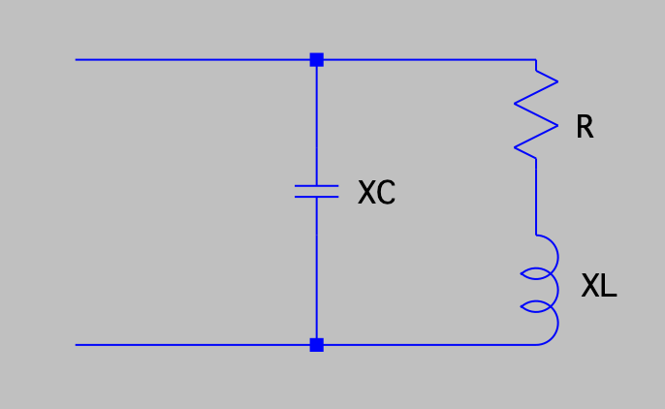

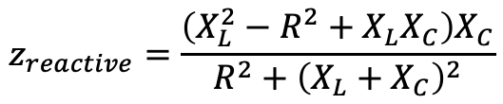
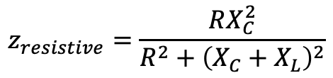

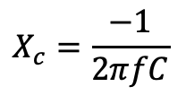

The math can get ugly
$$X_{L}=2πfL$$
$$X_{c}=\frac{−1}{2πfC}$$
z
$$z_{resistive}=\frac{RX_{C}^{2}}{{R^{2}+\left(X_{C}+X_{L}\right)}^{2}}$$
$$z_{reactive}=\frac{\left(X_{L}^{2}−R^{2}+X_{L}X_{C}\right)X_{C}}{R^{2}+{\left(X_{L}+X_{C}\right)}^{2}}$$
$$z_{resistive}$$
z
…Not so simple…Smith Charts to the rescue
$$z_{reactive}$$

Slide 19


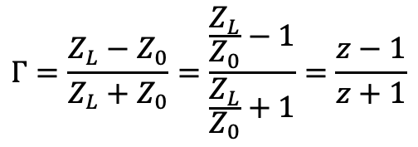

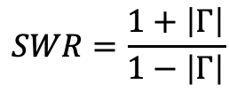
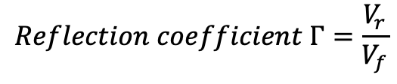

A few definitions
Transmission line with impedance of
$$Z_{0}$$
$$Z_{L}$$
$$Reflection coefficient Γ=\frac{V_{r}}{V_{f}}$$
$$V_{forward} or V_{f}$$
$$V_{reflected} or V_{r}$$
$$SWR=\frac{1+\left|Γ\right|}{1−\left|Γ\right|}$$
$$Γ=\frac{Z_{L}−Z_{0}}{Z_{L}+Z_{0}}=\frac{\frac{Z_{L}}{Z_{0}}−1}{\frac{Z_{L}}{Z_{0}}+1}=\frac{z−1}{z+1}$$
$$Normalized impedance=z=\frac{Z_{L}}{Z_{0}} usually Z_{0}=50 ohms in modern solid state radio systems$$
Smith Chart is a plat of the reflection coefficient as a function of normalized resistance and reactance
(and normalized admittance and susceptance)

Slide 20
Hand Out Smith Chart Paper

Slide 21
Let’s look at a Smith Chart
Red circles are for resistance, red arcs are for reactance
Inductive reactance above the horizontal axis (positive)
Capacitive reactance below the horizontal axis (negative)
Resistance and reactance help when we put elements in series
On red resistance lines, rotate clockwise to add more inductance, counterclockwise to add more capacitance
The r = 1 circle signifies 50 ohms resistance (pure or in series with a reactance)
Horizontal line through the center is pure resistance

Slide 22
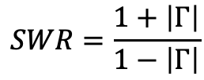
SWR
The vector from the origin to a point on the chart is reflection coefficient of that point
Magnitude of the reflection coefficient is the length of the vector
Phase of the reflection coefficient is angle of the vector to the x axis
We can read the SWR from the scale on the bottom of the page since:
$$SWR=\frac{1+\left|Γ\right|}{1−\left|Γ\right|}$$

Slide 23
You don’t have to remember the content of the last page,
it’s written on the Smith Chart

Slide 24
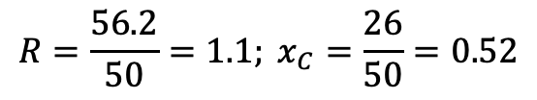
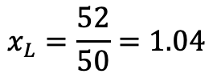
Let’s work out an example
My 40 meter antenna on top of the band (7.3 MHz) looks like a 56.2 Ohms resistor in series with a 26 Ohms (839 pF) capacitive reactance
First, we normalize these values:
$$R=\frac{56.2}{50}=1.1; x_{C}=\frac{26}{50}=0.52$$
Then we find the point for this value on the Smith Chart using the red part (lower half of the chart since it is capacitive)
Now let’s add a 1,134 nH inductor in series with it:
  First calculate the reactance of the inductor at 7.3 MHz
  Then normalize it to 50 ohms
  And travel by that amount on the constant resistance circle (since we are not changing the resistance)
$$X_{L}=2πfL=2×3.14×7.3×{10}^{6}×1,134×{10}^{−9}=52 Ohms$$
$$x_{L}=\frac{52}{50}=1.04$$
How did the SWR change?

Slide 25
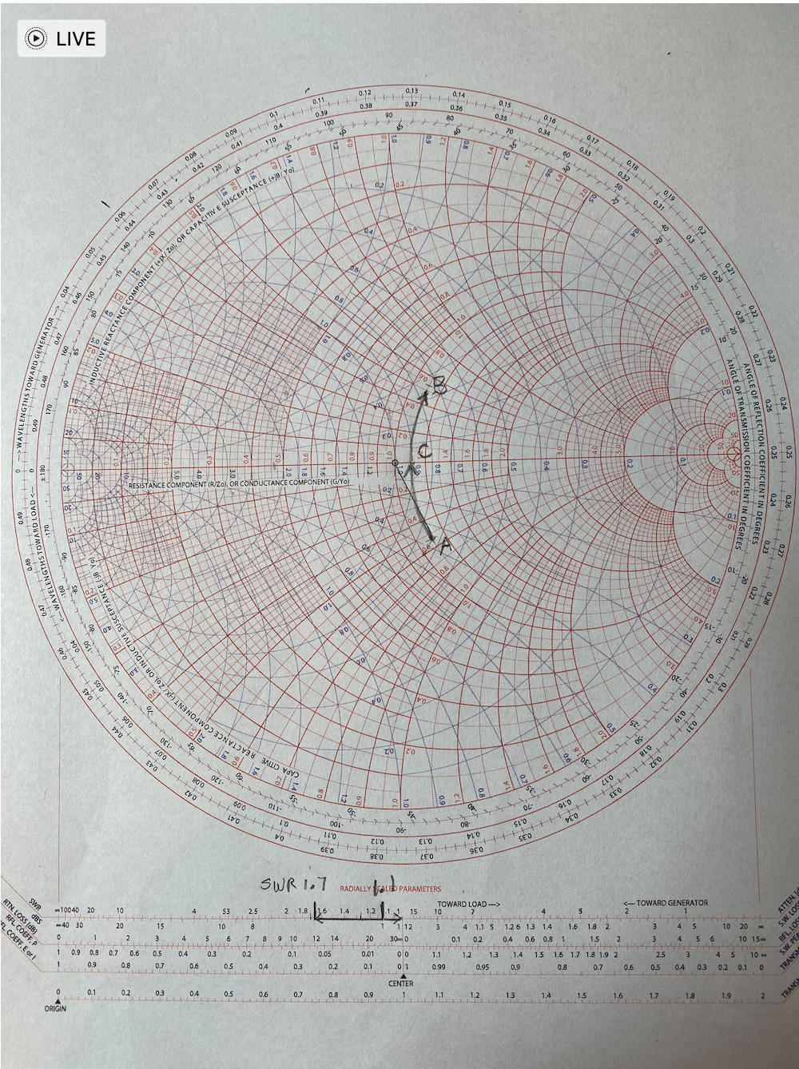

Slide 26
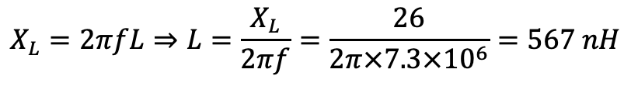
Let’s Find a (rough) match
A simple one component solution to get close to a match
Will it be an inductor or capacitor?
What is the best SWR we can achieve?
We need to move from a capacitive reactance of 0.52 to zero reactance
We need an inductance of the same and opposite value to resonate it out
$$x_{c}=−0.52; x_{L}=0.52; X_{L}=0.52 x 50=26 Ohms$$
$$X_{L}=2πfL⇒L=\frac{X_{L}}{2πf}=\frac{26}{2π×7.3×{10}^{6}}=567 nH$$

Slide 27
Let’s look at a Smith Chart
Blue circles are for conductance g (1/resistance) and blue arcs are for susceptance b (1/reactance)
Capacitive susceptance above the horizontal axis (positive)
Inductive susceptance below the horizontal axis (negative)
Conductance and susceptance help when we put elements in parallel
On blue lines, rotate clockwise to get more capacitance, counterclockwise for more inductance
The g = 1 circle signifies 1/50 ohms conductance (pure or in series with a reactance)
Horizontal line through the center is pure conductance

Slide 28


Let’s work out an example
My 15 meter antenna on top of the band (21.45 MHz) looks like a 23.3 Ohms resistor in series with a 12 Ohms inductive reactance
First, we normalize these values:
$$R=\frac{23.3}{50}=0.47; x_{L}=\frac{12}{50}=0.24$$
Then we find the point for this value on the Smith Chart using the red part (upper half of the chart since it is inductive)
Now let’s add a 97 nH inductor in series with it:
  First calculate the reactance of the inductor at 21.45 MHz
  Then normalize it to 50 ohms
  And travel by that amount on the constant resistance circle (since we are not changing the resistance)
$$X_{L}=2πfL=2×3.14×21.45×{10}^{6}×97×{10}^{−9}=13.1 Ohms$$
$$x_{L}=\frac{13.1}{50}=0.26$$

Slide 29


Let’s work out an example
Now let’s add a 353 nF capacitor in parallel with it:
  First calculate the reactance of the capacitor at 21.45 MHz
  Then normalize it to 50 ohms
  Calculate susceptance (1/reactance)
  And travel by that amount on the constant conductance circle (since we are not changing the resistance)
$$X_{C}=\frac{1}{2πfC}=\frac{1}{2×3.14×21.45{10}^{6}×353×{10}^{−9}}=47.6 Ohms$$
$$x_{C}=\frac{47.6}{50}=0.95; b_{C}=\frac{1}{x_{C}}=1.1$$
How did the SWR change?

Slide 30


Slide 31

Let’s find the equivalent circuit
All values are normalized to the system impedance

Slide 32


Slide 33


A transistor

Slide 34


Slide 35
Some of My antennas
40 m
20 m
15 m

Slide 36
Discussion

Slide 37


Slide 38




Quality Factor: Q
Parallel Circuit
If we want a C or L, then the resister in parallel with it is superfluous
The lower the resistor value, the more it interferes with the C or L
It lowers the “quality” of the circuit.
“Quality” is related to power dissipation which makes the part non-ideal
Q of a parallel circuit:
$$Q_{p}=\frac{R_{p}}{X_{p}}$$
If we want an L or C, then the resister in series with it is superfluous
The higher the resistor value, the more it interferes with the C or L
It lowers the “quality” of the circuit.
“Quality” is related to power dissipation which makes the part non-ideal
Q of a series circuit
Series Circuit
$$Q_{S}=\frac{X_{s}}{R_{s}}$$

Slide 39








Parallel to series transformation
$$Z_{s}=\frac{R_{p}(jX_{p})}{R_{p}+jX_{p}}$$
$$Z_{s}=\frac{R_{p}(jX_{p})}{R_{p}+jX_{p}}×\frac{R_{p}−jX_{p}}{R_{p}−jX_{p}}=\frac{R_{p}X_{p}^{2}+jX_{p}R_{p}^{2}}{R_{p}^{2}+X_{p}^{2}}$$
$$Z_{s}=\frac{R_{p}X_{p}^{2}}{R_{p}^{2}+X_{p}^{2}}+j\frac{X_{p}R_{p}^{2}}{R_{p}^{2}+X_{p}^{2}}=\frac{R_{p}}{1+\frac{R_{p}^{2}}{X_{p}^{2}}}+j\frac{X_{p}}{1+\frac{X_{p}^{2}}{R_{p}^{2}}}=\frac{R_{p}}{1+Q_{p}^{2}}+j\frac{X_{p}}{1+\frac{1}{Q_{p}^{2}}}$$
$$Z_{s}=R_{x}+jX_{s}$$
$$R_{s}=\frac{R_{p}}{1+Q_{p}^{2}}$$
$$X_{s}=\frac{X_{p}}{1+\frac{1}{Q_{p}^{2}}}$$

Slide 40
Solve this with smith chart
Antenna is not 50 ohms (say it is 200 ohms)
Add capacitor in parallel
Use parallel to series conversion to see the result
Cancel out the capacitor with an inductor

Slide 41

Match 70 ohms + 280 pF to 50 Ohms at 14.2 MHz
Calculate the reactance of the 280pF capacitor at 14.2 MHz: - 40 ohms
Normalize R and X to 50 ohms
r = 1.4 and x = - 0.8
Locate the point on the Smith Chart
Distance of this point to the origin is $\left|Γ\right|$
Lay it out on the SWR scale and we get 2.2
This point is on the susceptance arc of 0.3
We need to get to the r=1 circle
Point 2 sits on the susceptance arc of 0.5
We need to add a susceptance of -0.5 – (- 0.3) = -0.2
We need to add a reactance of -1/0.2 or -5
-5 x 50 ohms = -250 ohms or 45 pf in parallel with the load
Point 2 sits on the reactance arc of -0.9
So, we add a reactance of 0.9 or 45 ohms in series
Which is 505 nH at 14.2 MHz

Slide 42


n002

Slide 43



40 m
20 m
15 m

Slide 44
Recall Antenna Tuner Magic
Antenna is not 50 ohms (say it is 200 ohms)
Add capacitor in parallel
Use parallel to series conversion to see the result
Cancel out the capacitor with an inductor

Slide 45






Resistance Transformation*
$$Q_{p}=\frac{R_{p}}{X_{p}}$$
$$Q_{s}=\frac{X_{s}}{R_{s}}$$
$$R_{s}=\frac{R_{p}}{1+Q_{p}^{2}}$$
Example: 200 ohms load, want to match 50 ohms at 14.2 MHz (SWR = 4)
$$50=\frac{200}{1+Q_{p}^{2}}; Q_{p}=\sqrt{3}=1.732$$
Recall:
$$Q_{p}=\frac{R_{p}}{X_{p}}⇒1.732=\frac{200}{X_{p}}⇒ X_{p}=115.47 ohms$$
Also recall:
$$X_{c}=\frac{1}{2πfC}⇒115.47=\frac{1}{2×3.14×14.2×{10}^{6}C}⇒C_{p}=97 pF$$
*The math is in the last page

Slide 46




Two Equivalent circuits
Recall:
$$Q_{p}=Q_{s}=\frac{X_{s}}{R_{s}}⇒1.732=\frac{X_{s}}{50}⇒X_{s}=86.6 ohms$$
Also recall:
$$X_{s}=\frac{1}{2πfC}⇒86.6=\frac{1}{2×3.14×14.2×{10}^{6}C}⇒C_{s}=129.4 pF$$
We have the 50 ohms now, but what are we going to do with the C
We will resonate it out with an inductor with the same reactance
These two circuits are equivalent
Recall:
$$X_{L}=2πfL⇒86.6=2×3.14×14.2×{10}^{6}L⇒L=971 nH$$

Slide 47



Resonant Circuits cancel out
These two circuits are equivalent
The series inductance and series capacitance are in resonance with each other
$$\frac{1}{2π\sqrt{LC}}=\frac{1}{2×3.14×\sqrt{129.4×{10}^{−12}×971×{10}^{−9}}}=14.199 MHz$$
These two circuits are equivalent
…And we have an antenna tuner that matches a 200 ohms load to a 50 ohms source

